Slide 1



Our Agenda
Learning all about LinkedList - Singly

Slide 2

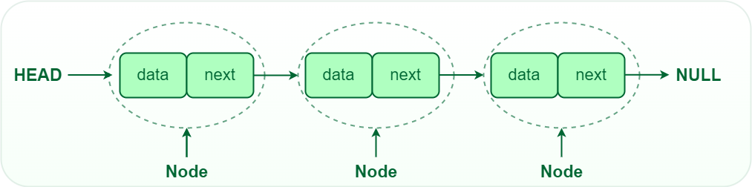

What is Linked List in DS?
A linked list is a linear data structure consisting of a sequence of elements called nodes.

Slide 3
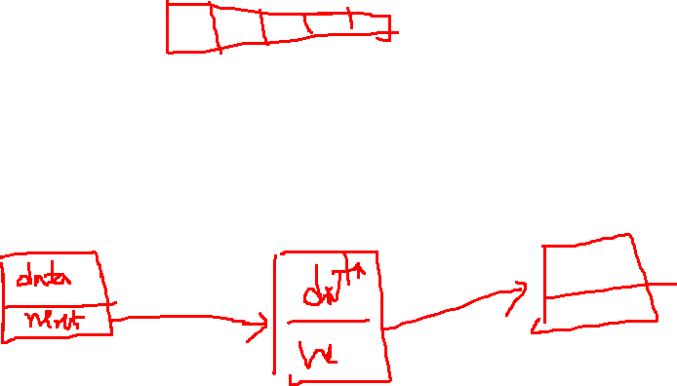
What is Node in Linked List?
A node is the basic building block of a linked list.
It's like a little container that holds two things:
Data
Next (Pointer)

Slide 4
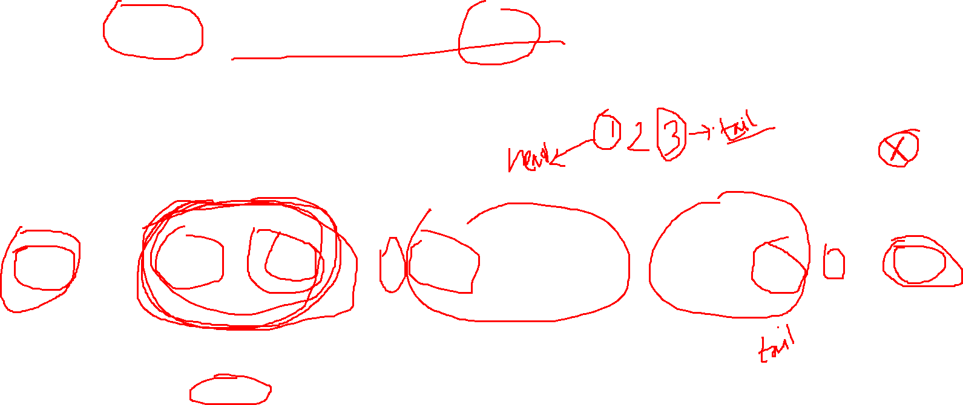
Breakdown of Node
Data: Holds the value of the element.
Next (Pointer): Points to the next node in the sequence.

Slide 5


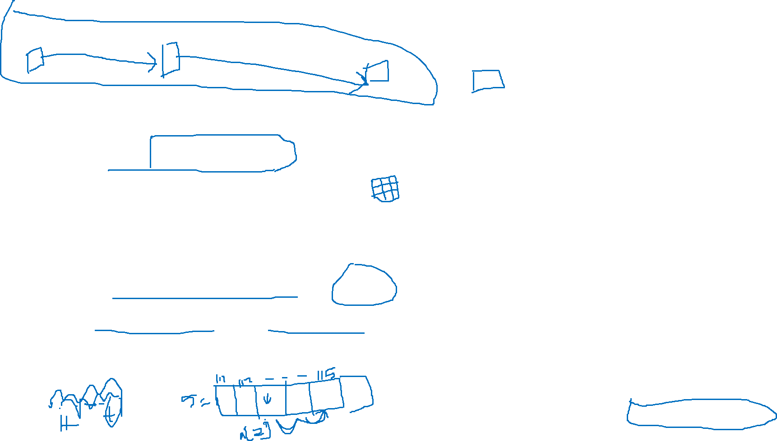
Advantages and Disadvantages
Linked lists have slower random access than arrays.
Each linked list node requires extra memory for references.
Linked lists entail complex implementation compared to arrays.
Linked lists may have limited cache efficiency.
Traversing linked lists, especially in reverse, can be cumbersome.
Non Contiguous (Flexible Memory Allocation)
Dynamic size (not fixed size unlike array)
Time Complexity is O(1) in insertion and deletion (compare to arrays)

Slide 6


What we will do?
Operation To Do
Goals
Quick Write
Will Implement with generics type
addFirst()
showData()
addLast()
deleteFirst()
deleteLast()
getSize()
Nothing here actually but implementation of the LinkedList class (singly)

Slide 7
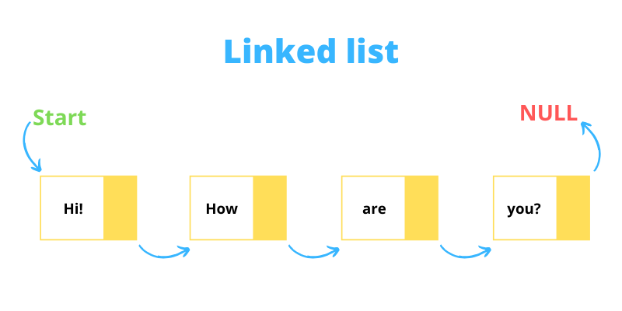


Example of Singly LinkedList

Slide 8
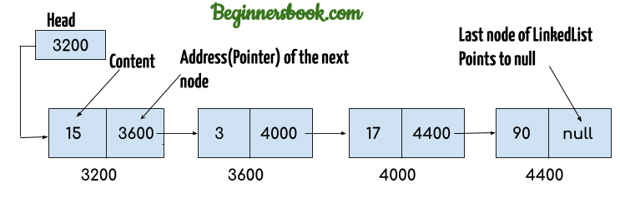

Example of Singly LinkedList(2)

Slide 9



Give me a thank if you love this video
@alamin5g
@alamin5g

